Slide 1
Brooklyn Armenian School
Website Map
Authors:
Arman Melkumyan
Anna Turovtseva

Slide 2
Main Menu - PC Browser version
https://www.brooklynarmenians.org/
Home
News
Registration
Existing Student Registration 2020-202
New Student Registration
New Community Member Registration
Calendar
Students Projects
Donate
Contact Us
Profile
Attendance Reports 2020-2021
Attendance Reports 2019-2020
Attendance Reports - All
Teachers Attendances Reports 2020-2021
Post News
My Account
Atendances-2019-2020
Attendances Forms
Teachers Attendances Reports 2019-2020
Attendances Reports 2018-2019
Log Out
Main menu
Members menu

Slide 3
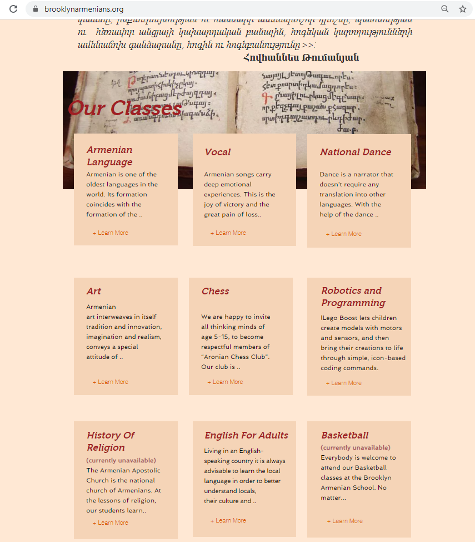
Home Page
(All classes) PC Version
https://www.brooklynarmenians.org/

Slide 4
News Page PC Browser version
https://www.brooklynarmenians.org/news

Slide 5
Post’s Page PC Browser version
Select any post from the News page
https://www.brooklynarmenians.org/post/manage-your-blog-from-your-live-site

Slide 6
Registration- Submenu & Page PC version
https://www.brooklynarmenians.org/registration

Slide 7
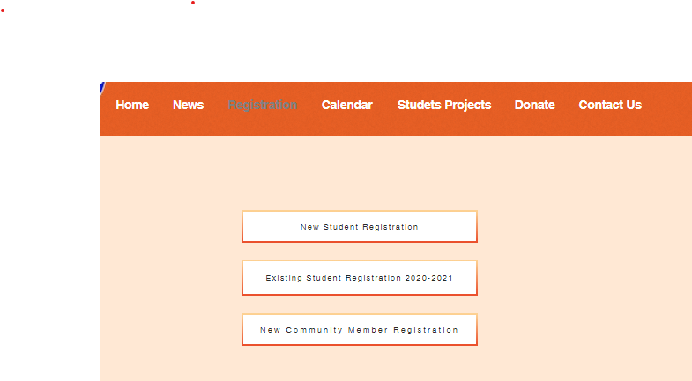
New Students Registration Page PC version
Click here
https://www.brooklynarmenians.org/new-student-registration

Slide 8
Existing Students Registration Page PC version
This is a short form for previously registered students
Click here
https://www.brooklynarmenians.org/student-registration-2020-2021

Slide 9
New Students Registration Page PC version
If the student has already been registered in our school (last 2 years), please submit this short form to register for new educational year. The email address is required to use for the online classes, video meeting invitations and home tasks assignments.
https://www.brooklynarmenians.org/student-registration-2020-2021

Slide 10
New Community Member Registration Page PC version
Would you like to register to Brooklyn Armenian Community?
Click here
https://www.brooklynarmenians.org/community-member-registration

Slide 11
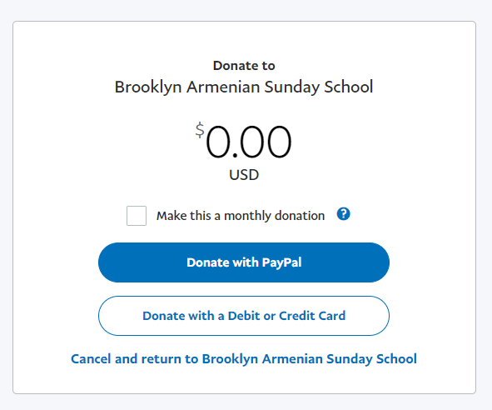
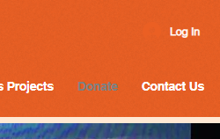
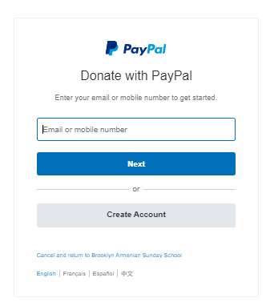
Tuitions and Donations Menu & Page PC version
3
2
1
Click here
You can pay tuition or donation as via pay account as by credit card as you like.

Slide 12
Tuitions and Donations Menu & Page PC version
You can pay tuition by credit card as well.

Slide 13
Calendar Page PC version
https://www.brooklynarmenians.org/calendar

Slide 14
Students Projects Page PC version
https://www.brooklynarmenians.org/studets-projects

Slide 15
Home Page Mobile version

Slide 16
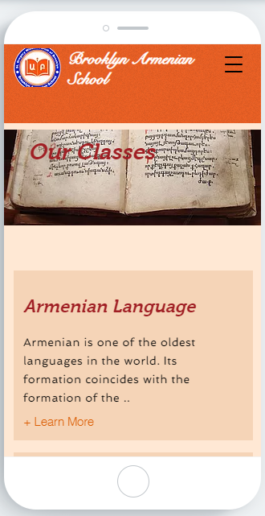
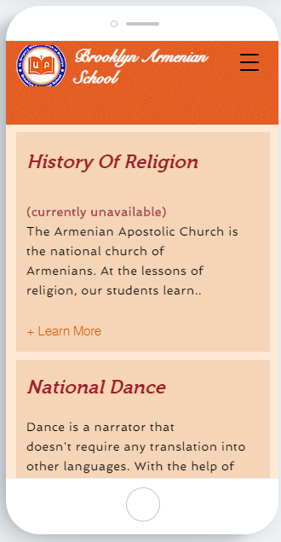
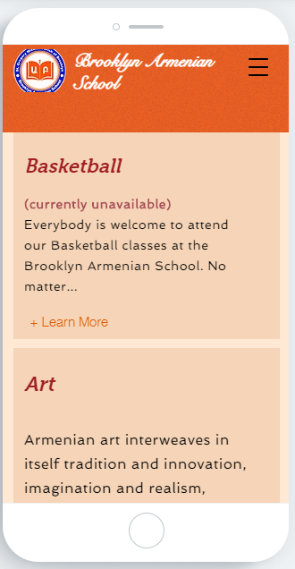
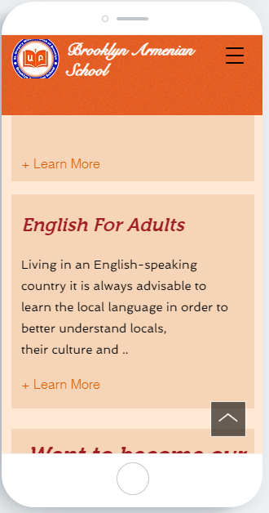
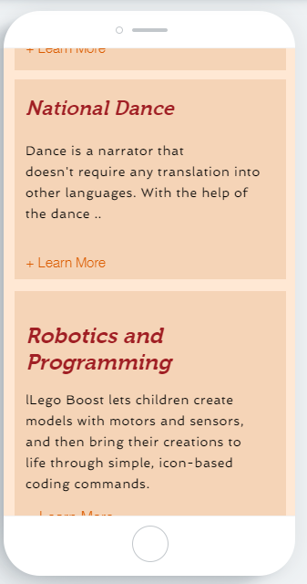
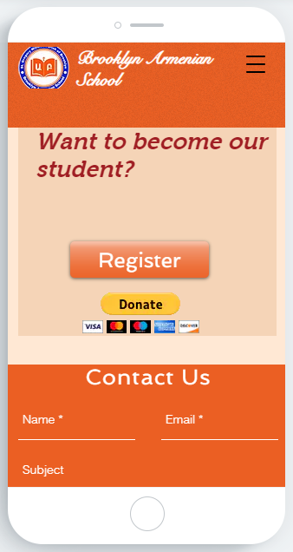
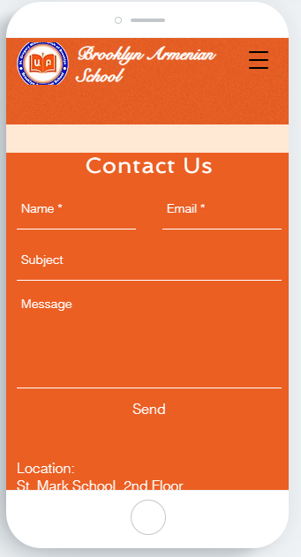
Home Page
(All classes) Mobile Version
https://www.brooklynarmenians.org/

Slide 17
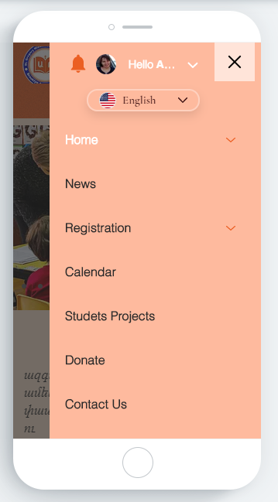
Home - Submenu – Mobile Version
Submenu –Home Mobile Version

Slide 18
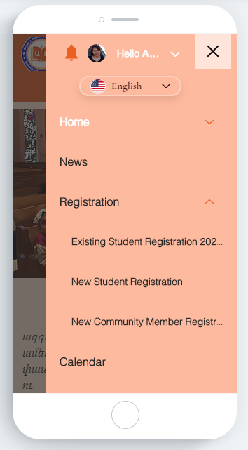
Registration - Submenu– Mobile Version
Submenu – Registration - Mobile Version

Slide 19
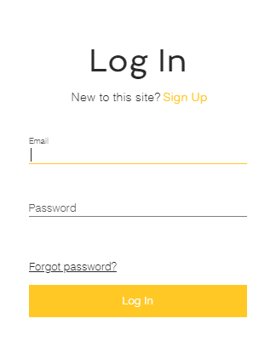
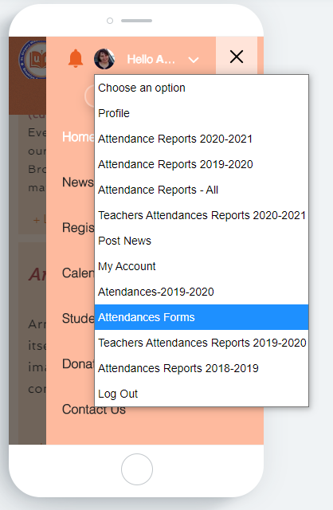
Member’s Menu – Submenu – Mobile Version
1
2
If you are a teacher of this school - login first. Use your username and password
Click here
Submenu Resources only for site members
-
3

